Slide 1
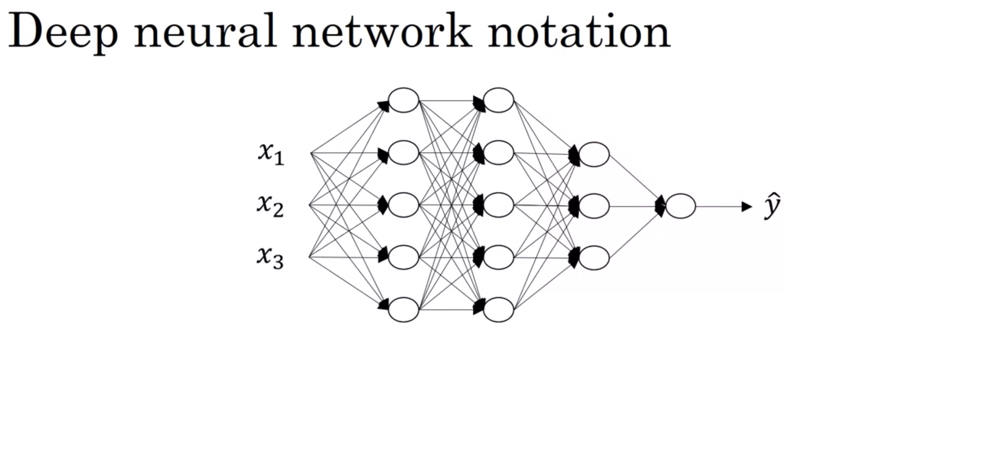

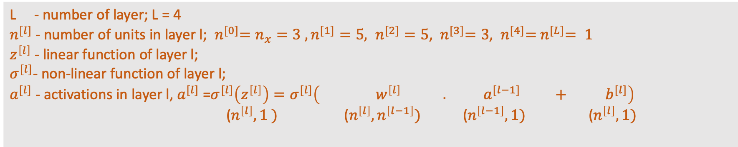

4 layer NN
- considering one input only -
Input
Layer “0”
Layer 1
Layer 2
Layer 3
Layer 4
X = $\left[\begin{matrix}x_{1} \\ x_{2} \\ x_{3}\end{matrix}\right]=$ $a^{[0]}$
= $a^{[L]}$
There are 2 types of number in a NN:
Parameter: weight and bias
Activation
L - number of layer; L = 4
$n^{[l]}$- number of units in layer l; ${ n}^{[0]}=n_{x}=3 , n^{[1]}=5, n^{[2]}=5$, ${ n}^{[3]}=3$, ${ n}^{[4]}={ n}^{[L]}= 1$
$z^{\left[l\right]}$ - linear function of layer l;
$σ^{[l]}$- non-linear function of layer l;
$a^{[l]}$ - activations in layer l, $a^{[l]}$ =$σ^{[l]}\left(z^{\left[l\right]}\right)=σ^{[l]}\left({ w}^{\left[l\right]} . a^{[l−1]} +{ b}^{[l]}\right)$
($n^{\left[l\right]},1$ $) \text{(}n^{\left[l\right]},n^{\left[l−1\right]})$ $\text{(}n^{\left[l−1\right]},1)$ $\text{(}n^{\left[l\right]},1)$

Slide 2

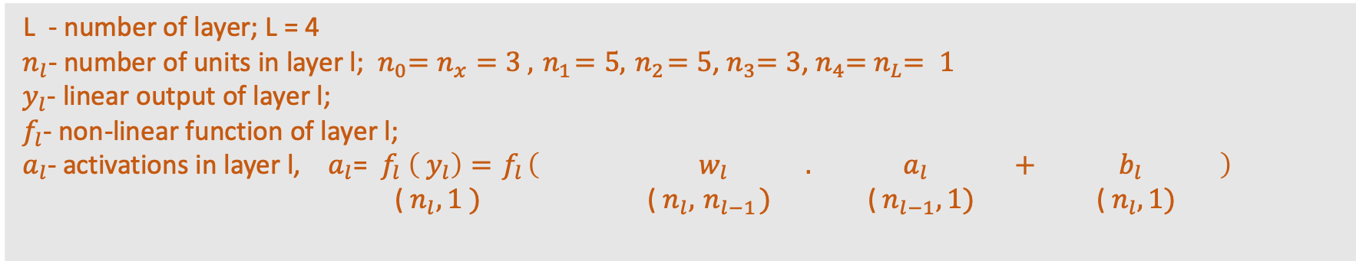

4 layer NN
- considering one input only -
Input
Layer “0”
Layer 1
Layer 2
Layer 3
Layer 4
X = $\left[\begin{matrix}x_{1} \\ x_{2} \\ x_{3}\end{matrix}\right]={ a}_{0}$
=${ a}_{L}$
There are 2 types of number in a NN:
Parameter: weight and bias
Activation
L - number of layer; L = 4
${ n}_{l}$- number of units in layer l;${ n}_{0}=n_{x}=3 ,{ n}_{1}=5,{ n}_{2}=5$,${ n}_{3}=3$,${ n}_{4}={ n}_{L}= 1$
${ y}_{l}$- linear output of layer l;
${ f}_{l}$- non-linear function of layer l;
${ a}_{l}$- activations in layer l, ${ a}_{l}$= ${ f}_{l} \left({ y}_{l}\right)={ f}_{l}\left({ w}_{l} .{ a}_{l} +{ b}_{l} \right)$
(${ n}_{l},1$ $) \text{(}{ n}_{l},{ n}_{l−1})$ $\text{(}{ n}_{l−1},1)$ $\text{(}{ n}_{l},1)$

